Slide 1
ANIE-IEASA WEBINAR (Implications of COVID-19 on Higher Education and Internationalisation in Africa): 02 July 2020
IMPACT OF CODIV-19 ON HIGHER EDUCATION IN AFRICA and FUTURE SCENARIOS
By
PAI OBANYA

Slide 2
A DISCUSSION IN TWO PARTS
A. KEY LESSONS FROM THE PANDEMIC
B. FUTURE DIRECTIONS: AN AFRICAN PERSPECTIVE

Slide 3
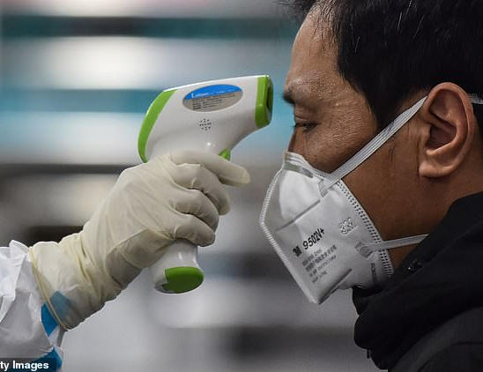
PART A
What has the pandemic done to higher education in Africa?

Slide 4
MAJOR IMPACT

Slide 5
Secondly: PROMOTION OF VIRTUAL LEARNING

Slide 6
TWO LESSONS FROM OUR ATTEMPTS TO GO VIRTUAL
1. For you to be properly ON-LINE, you would need to be firmly IN-LINE
2. HUMANWARE is needed to drive both HARDWARE and SOFTWARE

Slide 7
Thirdly, worsening of INEQUITIES
Socio-economic
Geographical

Slide 8
Fourthly: A CURRICULUM DEFICIT SYNDROME
Neglect of
SOFT SKILLS
And
IMPLICIT CURRICULAR ENGAGEMENTS

Slide 9
Fifthly: SEVERE CUT-DOWNS
TEACHING
RESPONSIVE SOCIAL ENGAGEMENT
RESEARCH

Slide 10
PART B: FACING THE FUTURE

Slide 11
ONE ADDRESSING THE TRANSFORMATIONS NEEDS OF AFRICAN UNIVERSITIES

Slide 12
SIX MAJOR DIRECTIONS
1. Connecting with the SOCIAL LABORATORY
2. Greater attention to the RAF research model
3. Greater recognition of RESPONSIVE SOCIAL ENGAGEMENT for academic advancement
4. Transforming the lecture from a FACE TO FACE activity to a MIND TO MIND ENGAGGEMENT
5. E-LEARNING PEDAGOGY as an integral part of career-long pedagogy training for academics
6. Breaking the EQUITY DIVIDE in higher education

Slide 13
TWO PURSUIT OF INTERNATIONALISATION

Slide 14
(a): GUIDING PRINCIPLES
1. CODIV-19 has shown that the real world knows no physical/socio-economic/racial/technological boundaries
2. KNOWLEDGE is for adding value to human life-wherever/in whatever condition
3.To be profitable, internationalisation must promote GENUINE PATRNERSHIP

Slide 15
(b): CONCRETE ACTION
1. Placing African Universities (and African nations) IN –LINE so that they can effectively come ON-LINE
2. Strengthened partnerships with the private sector for sustainable HUMANWARE development
3. IN-COUNTRY and CROSS-COUNTRY fortification as starting point for African universities
4, ACADEMICE EXCELLENCE AS INTERNATIONAL CURRENCY: pursing our mission devoid of fear and interference
5. GLOCALISATION

Slide 16
CONCLUDING with my model of INTERNATIONALISATION
Mutual Occupation of
and Mutually Fitting into
a Shared and Common
Universe of Learning

Slide 17
EVERYONE CONTRIBUTING AND EVERYONE BENEFITING
AFRICA
MIDDLE EAST
EUROPE
GLOBAL POOL
ASIA/PACIFIC
LATIN AMERICA & CARRIBEAN
NORTH AMERICA

Slide 18
ASANTENI SANA

